Slide 1
“Do You Have Any Moon Units”
By Jim Park, PhD
An adaptation of a presentation
delivered at the 17th Annual
AIIAS Theological Forum
November 1, 2014

Slide 2
Do You Have Any Moon Units?

Slide 3
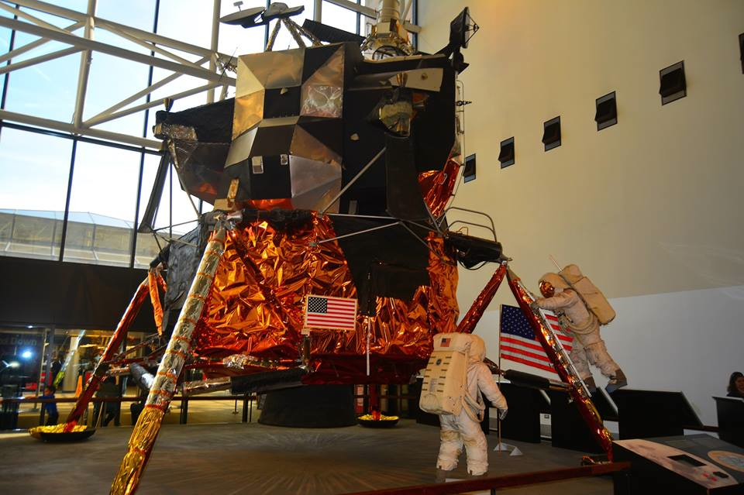
Do You Have Any Moon Units?

Slide 4
Do You Have Any Moon Units?
Three Causes
Pioneer Influence
The West knows Best
Benchmarking

Slide 5
Do You Have Any Moon Units?
“Edinburgh 1910 highlighted the strategic importance of
(theological) education as an indispensable element
of any Christian mission both in the past and the future.
Bishop Gore, Chairman of Commission III stated . . . ‘nor
can it be doubted how important a part of education has
played in the process of evangelization.”
“We wish to lay it down that we believe that the primary
purpose to be served by the educational work of the
missionaries is that of the training of the native Church
to bear its own proper witness.”
“Theological Education in the changing context of World Christianity – an unfinished agenda”, Dietrich Werner, Geneva

Slide 6
Do You Have Any Moon Units?
“In the work of training the native Christian Churches, and in particular those who are to be the leaders of the Churches, the greatest possible care will have to be taken to avoid the risk of denationalizing those who are being trained.”
“It can be argued therefore that the famous statement
of the Tambaran world mission conference 1938, The
weakest element in the enterprise of Modern Missions
is theological education.”
“Theological Education in the changing context of World Christianity – an unfinished agenda”, Dietrich Werner, Geneva

Slide 7
Do You Have Any Moon Units?
“Voices from Africa and Asia point to a decline in the commitment for contextualized theologies and declining numbers of books published on Asian or African theologies. Instead there is an increased trend to create affiliated programmes of American, Asian or other Western theological colleges to operate as branches in countries of the South, so that some voices speak of ambivalent trends of Koreanization or Americanization of theological education in Asia or Africa.”
“Theological Education in the changing context of World Christianity – an unfinished agenda”, Dietrich Werner, Geneva

Slide 8
Do You Have Any Moon Units?
“While the plea of Edinburgh 1910 to develop
contextualized forms of theological education in the
Asian churches was partly answered by some indigenous models of theological education . . . .
Western patterns and concepts of theology continue
to be exported to throughout the Global South, so the task of Edinburgh 1910 was only gradually and incompletely fulfilled.”
“Theological Education in the changing context of World Christianity – an unfinished agenda”, Dietrich Werner, Geneva

Slide 9
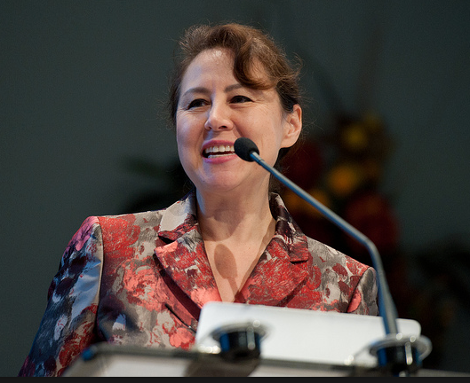
Do You Have Any Moon Units?
“Would AAA be opposed to having
more courses which reflect the local context of the country”
“As long as it does not take away from the Biblical Studies portion of the curriculum.”
Biblical
Studies
Implement the teaching of at least one
three unit course per year which would
study both the theological understanding
and effectively ministering to the primary
religious group within the area.
Theological
Historical
Applied
Theology

Slide 10
Do You Have Any Moon Units?
Implement the teaching of at least one
three unit course per year which would
study both the theological understanding
and effectively ministering to the primary
religious group within the area.

Slide 11
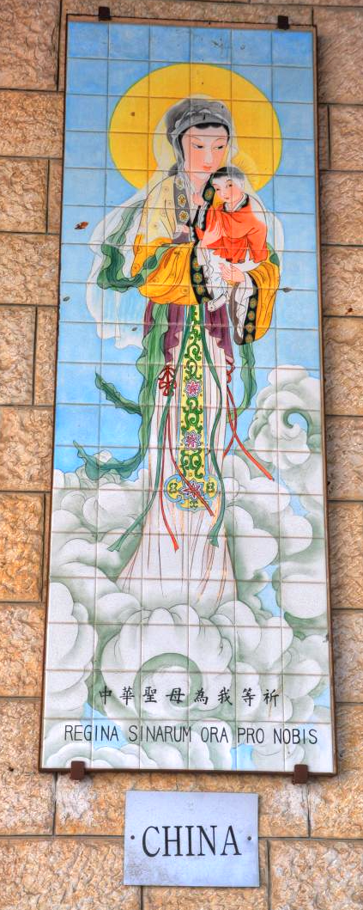
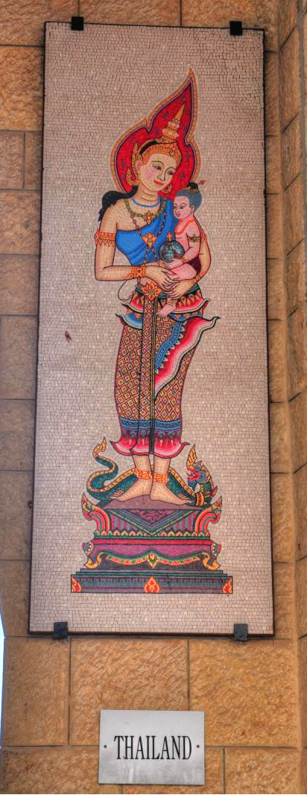
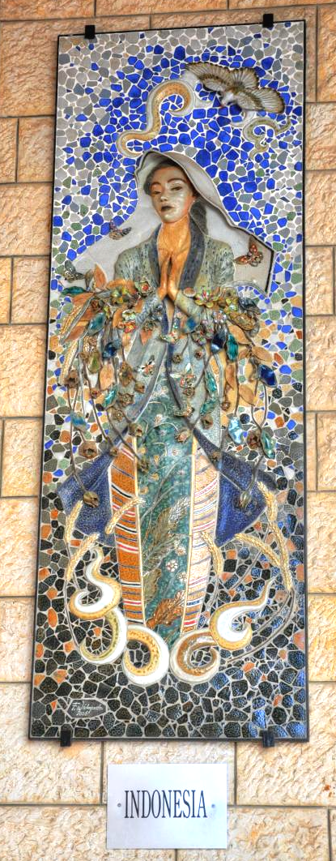
The Asian Face of Jesus
Like
Don’t
Know
Don’t
Like

Slide 12
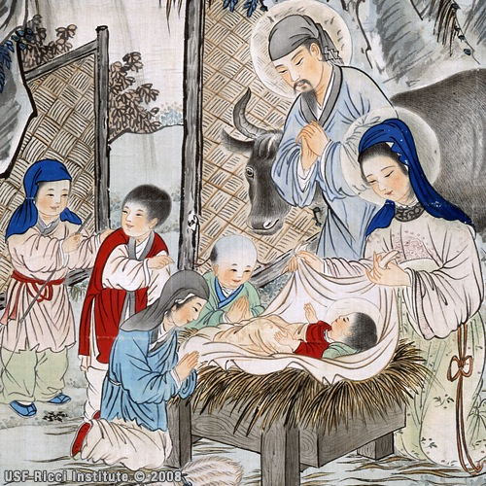
The Asian Face of Jesus
Like
Don’t
Know
Don’t
Like

Slide 13
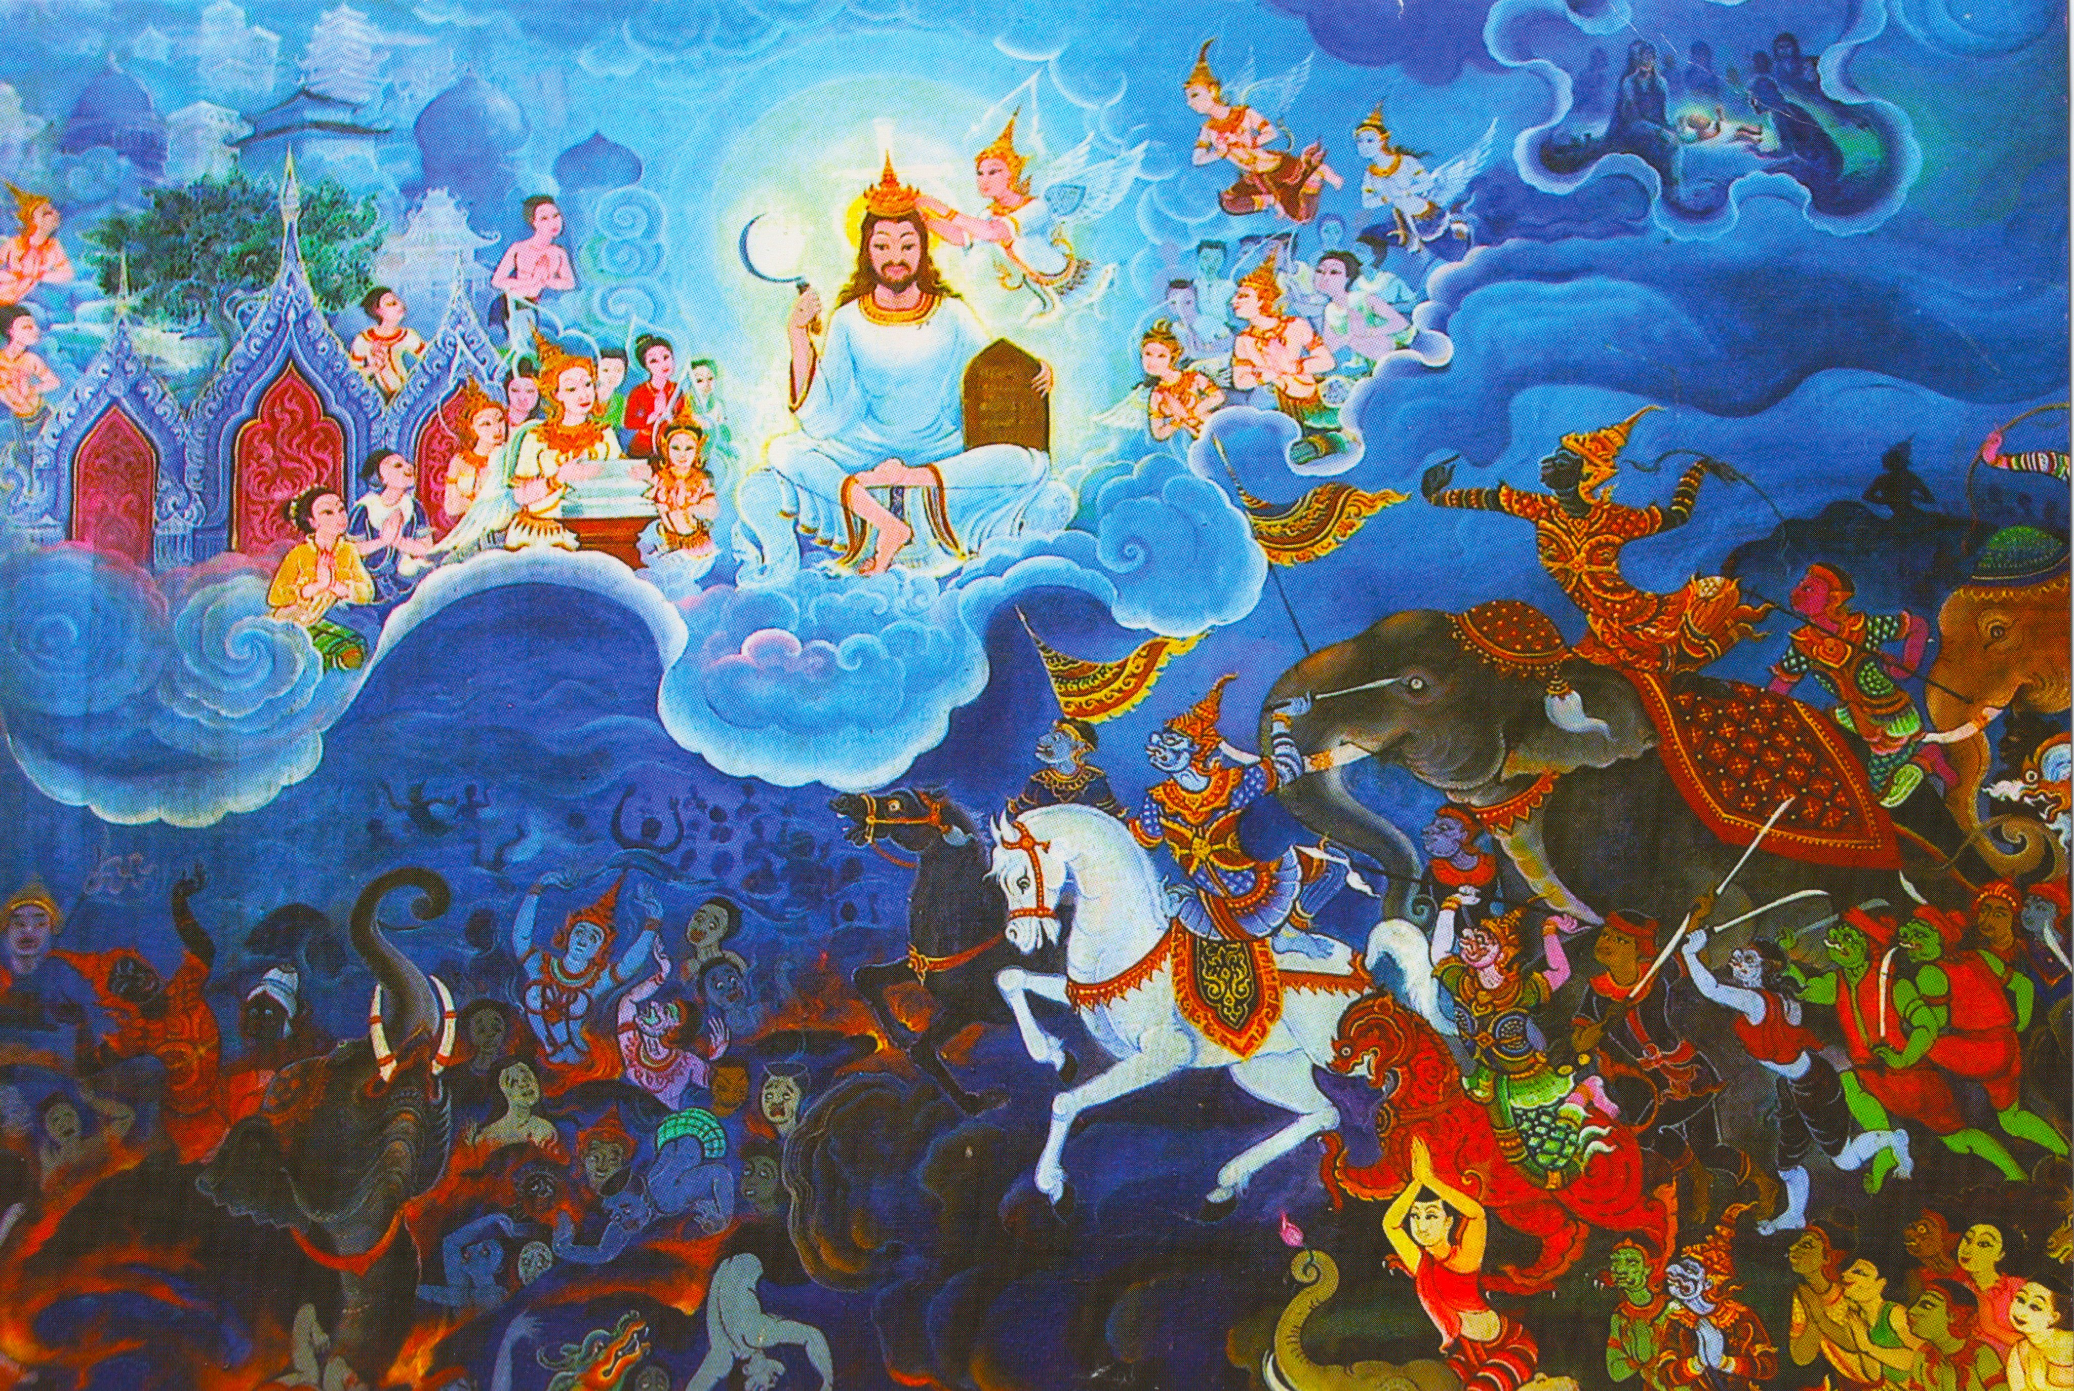
The Asian Face of Jesus
Like
Don’t
Know
Don’t
Like

